Slide 1
Modal decomposition for control of MIMO system

Slide 2
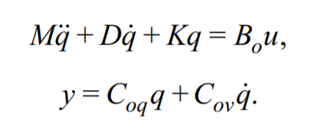
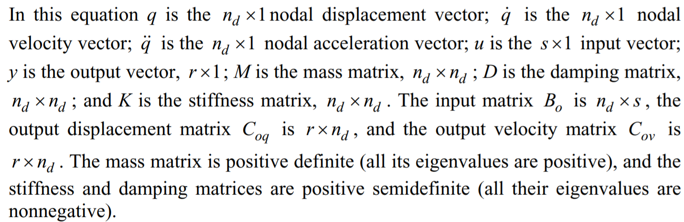
Nodal model
Dynamic equation of motion

Slide 3
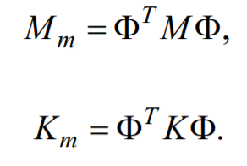
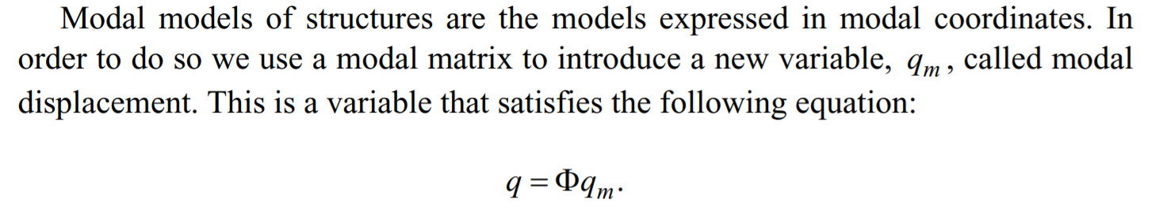
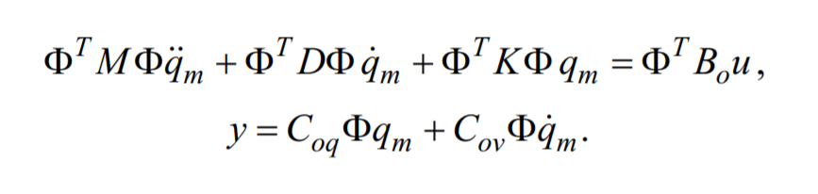
Modal model
Modal mass and stiffness matrix

Slide 4
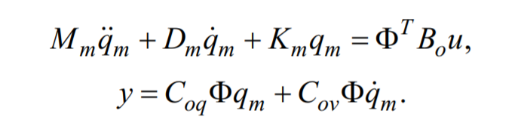
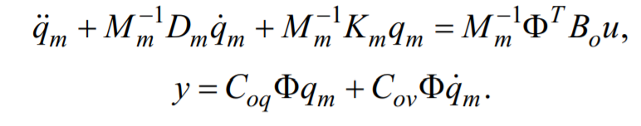
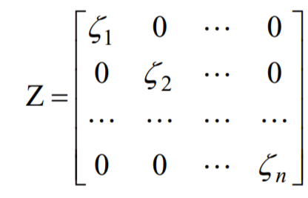
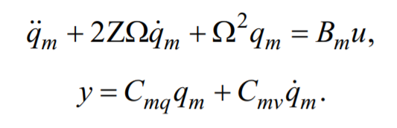
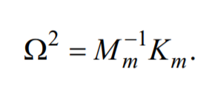
Modal model
Dynamic equation in modal coordinates

Slide 5



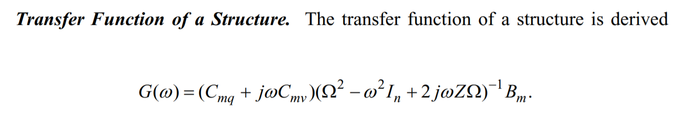

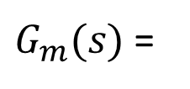
Modal model
Modal input matrix:
Modal output matrix:
$G_{m}(s)$ =

Slide 6

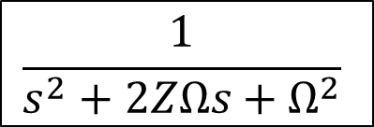



Modal model
Block diagram:
Design procedure
  Design SISO controller for the modal matrix
  Obtain full block controller as
$$\frac{1}{s^{2}+2ZΩs+Ω^{2}}$$
$$B_{m}$$
$$C_{mq}+sC_{mv}$$
Modal input matrix
Modal output matrix
Diagonal modal matrix
$$\tilde{K}=diag(k_{1},…,k_{n})$$
$$K=B_{m}^{−1}\tilde{K}{\left(C_{mq}+sC_{mv}\right)}^{−1}$$

Slide 7
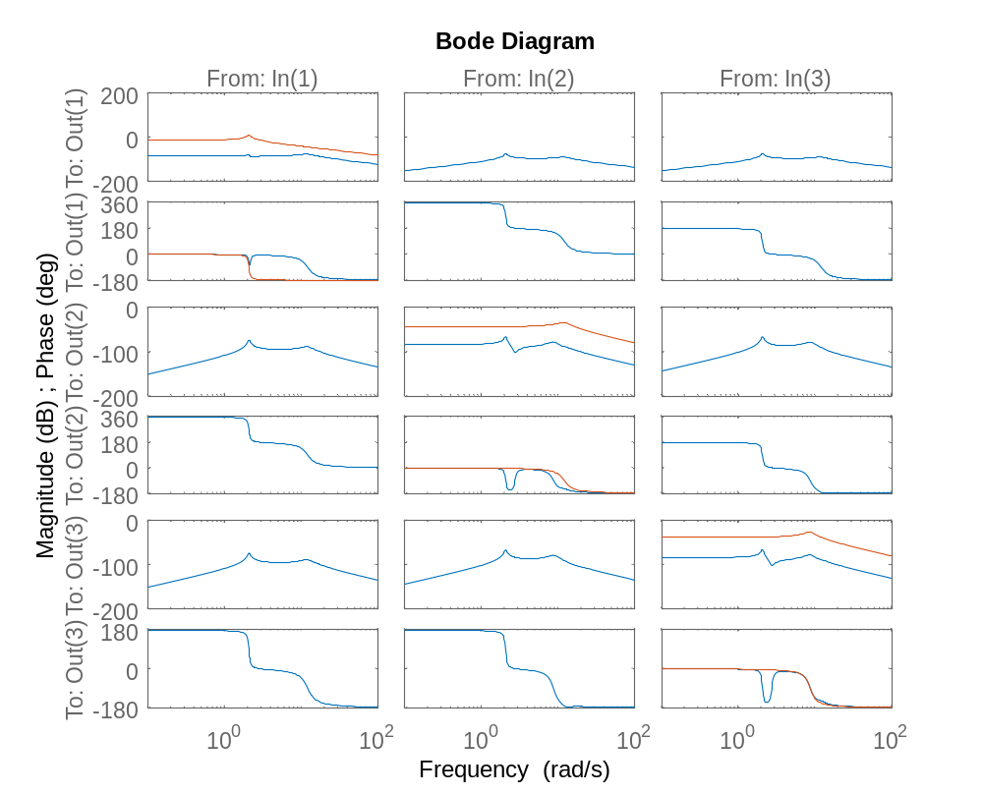
Gravimeter model
[V,D] = eig(M\K);
Mm = V'*M*V; % Modal mass matrix
Dm = V'*C*V; % Modal damping matrix
Km = V'*K*V; % Modal stiffness matrix
Bm = inv(Mm)*V'*Jta; Cm = [Jah;Jav]*V;
omega = real(sqrt(inv(Mm)*Km));
zeta = real(0.5*inv(Mm)*Dm*inv(omega));
Gm = [1/(s^2+2*zeta(1,1)*omega(1,1)*s+omega(1,1)^2),0,0;
0,1/(s^2+2*zeta(2,2)*omega(2,2)*s+omega(2,2)^2),0;
0,0,1/(s^2+2*zeta(3,3)*omega(3,3)*s+omega(3,3)^2)];
bode(G,Gm)

Slide 8
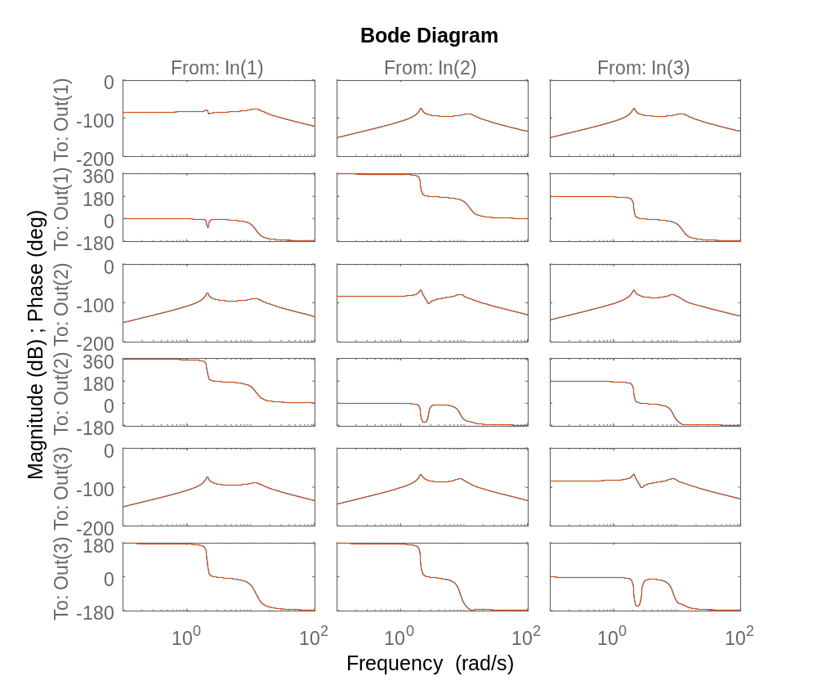
Gravimeter model
figure(1)
bode(G,Cm*Gm*Bm)

