Slide 1


Group meeting 16/12/2019
Mohit Verma

Slide 2
Outline
Introduction
Analytical model
Multi-body simulation of Stewart Platform
Preliminary experiments
Future Plan

Slide 3
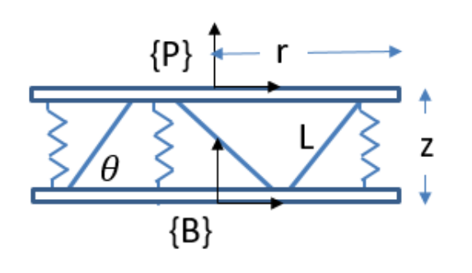
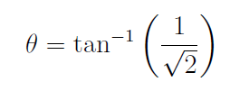
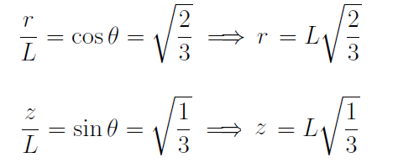
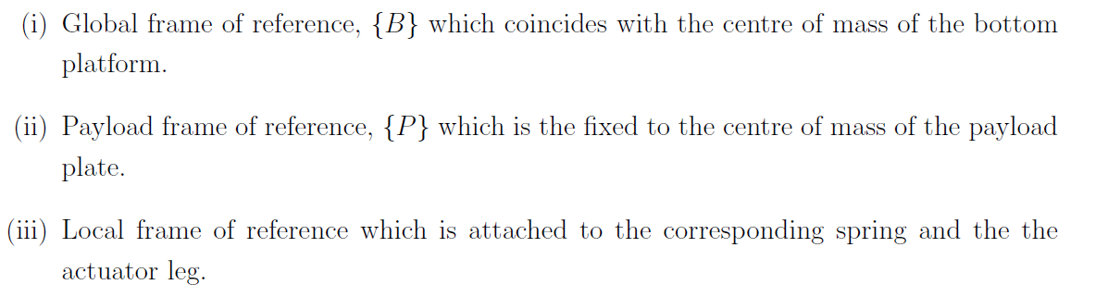
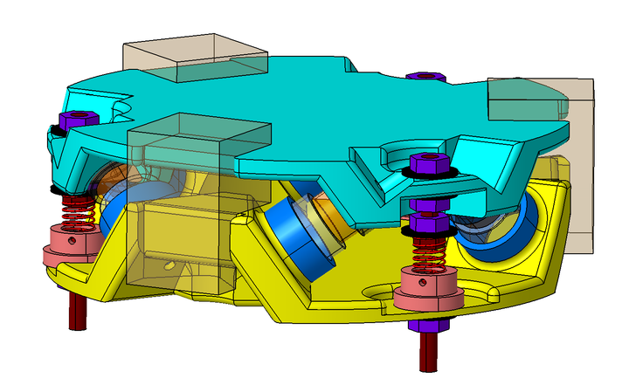


Modelling of Stewart Platform
Geometric configuration for cubic architecture
Frame of reference
$$\{P\}$$
$$\{B\}$$

Slide 4
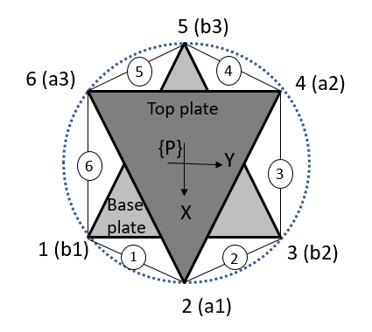
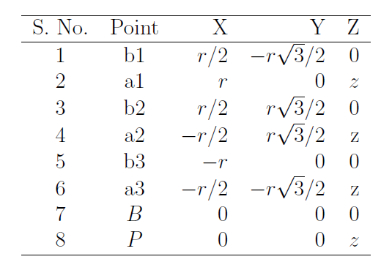
Modelling of Stewart Platform
Location of actuators and sensors in global frame of reference

Slide 5
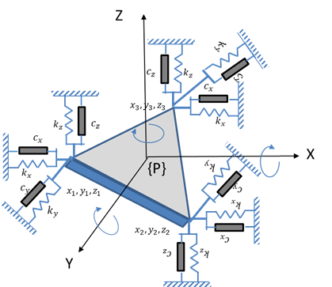

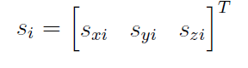
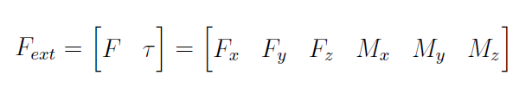
Modelling of Stewart Platform
Modelling of springs
Motion of payload plate
Displacement of i^{th} spring
External force acting on the center of mass of the payload plate

Slide 6



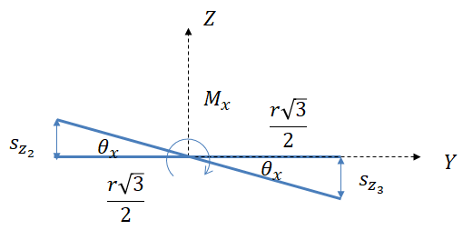
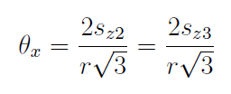
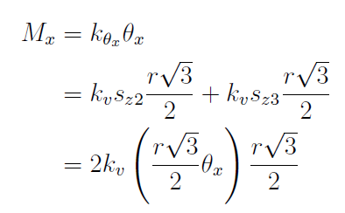

Modelling of Stewart Platform
Relation between spring motion and payload motion
Translation in X-, Y- and Z-directions
Rotation about X-axis

Slide 7
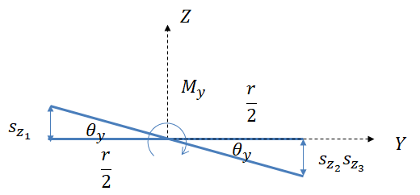

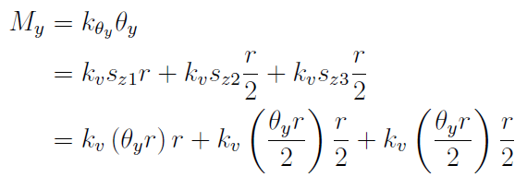

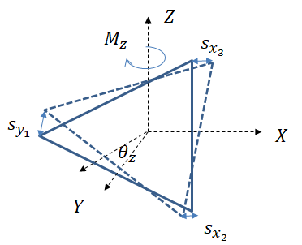

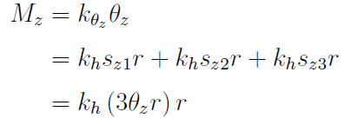

Modelling of Stewart Platform
Relation between spring and payload displacements
Rotation about Y-axis
Rotation about Z-axis

Slide 8
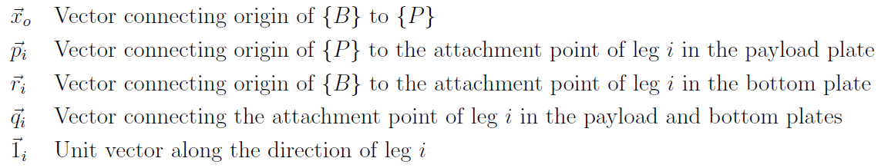
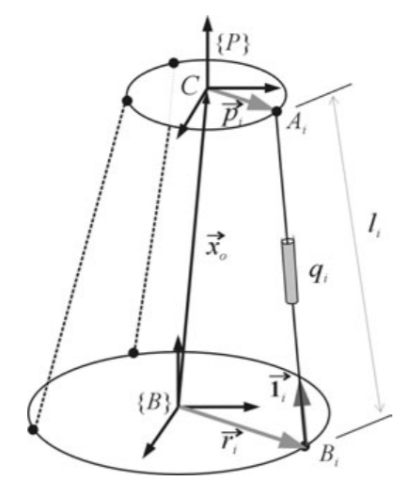


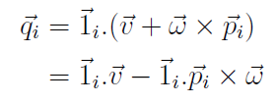

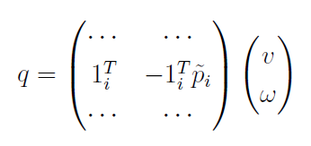
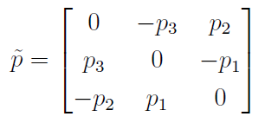
Modelling of Stewart Platform
Kinematic modelling of actuators
Jacobian
Absolute velocity of point A
Projection along the actuator leg
[Hanieh, 2003]

Slide 9
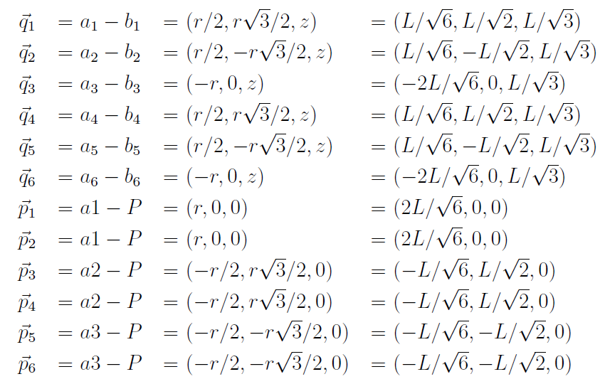
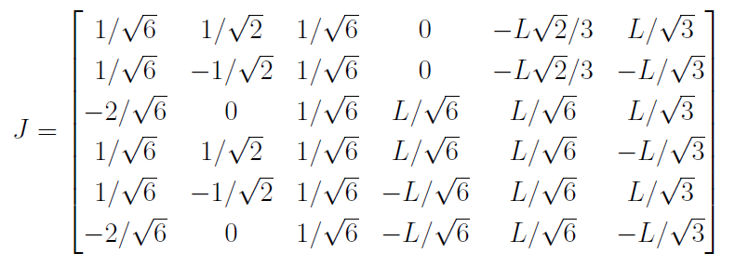
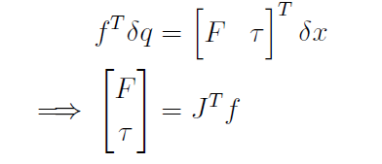
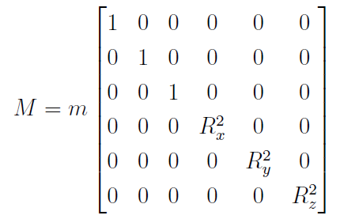
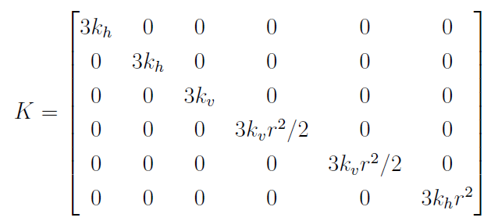

Modelling of Stewart Platform
Vectors corresponding to actuator leg and position
Dynamic equation of the platform

Slide 10





SVD controller design
Centralized controller
SVD controller design
Transfer matrix is complex matrix which is dependent on the frequency.
Select decoupling frequency and carry out SVD on the real approximation of the matrix.
G
$$B_{a}^{−1}$$
H
$$J_{s}^{−1}$$
G
$$V^{−T}$$
H
$$U^{−1}$$

Slide 11
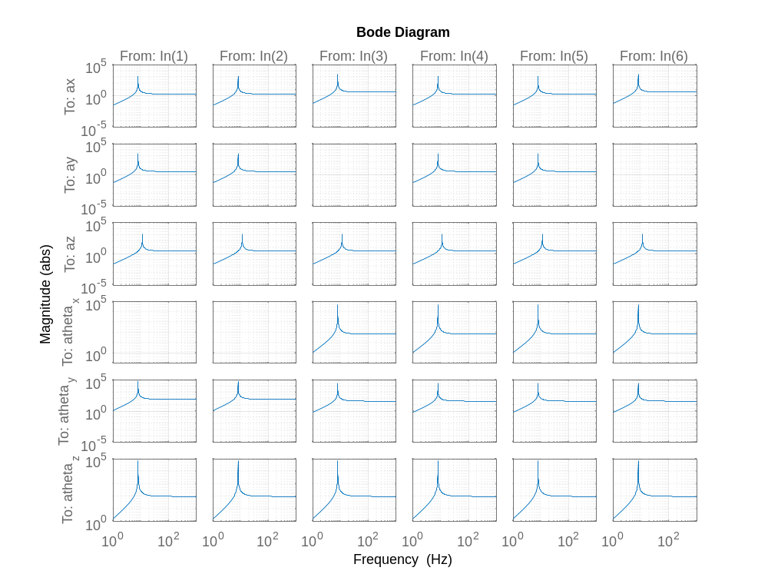

Actuator to sensor
$a$ (out)
f(in)

Slide 12
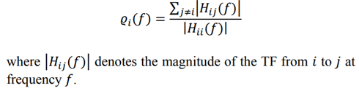
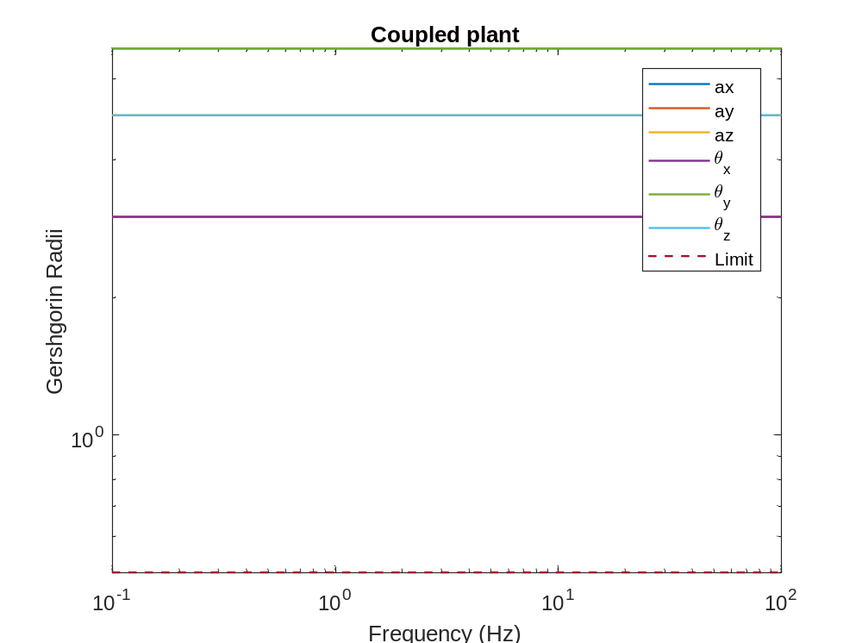
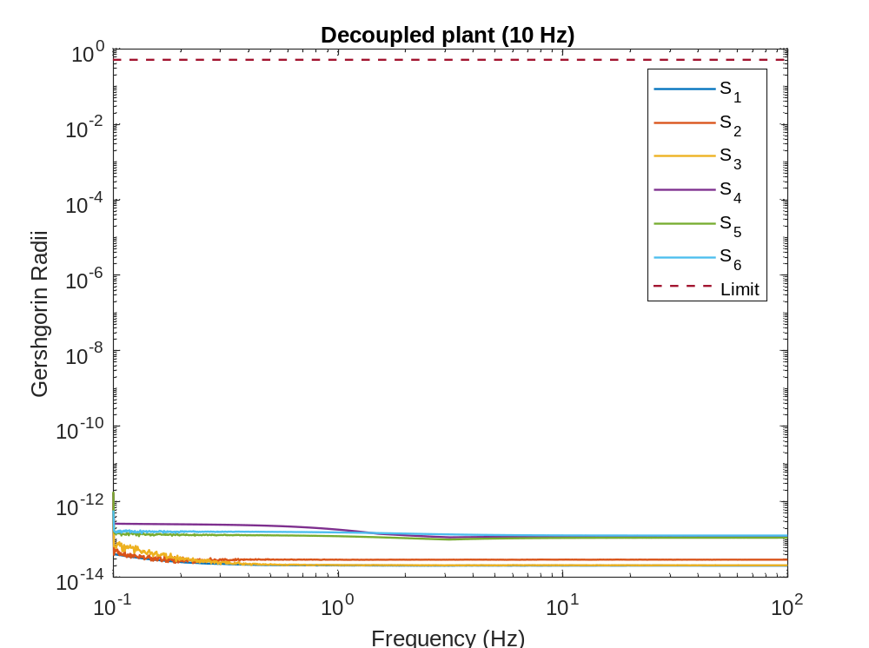
Greshgorin radii
Check for diagonal dominance

Slide 13
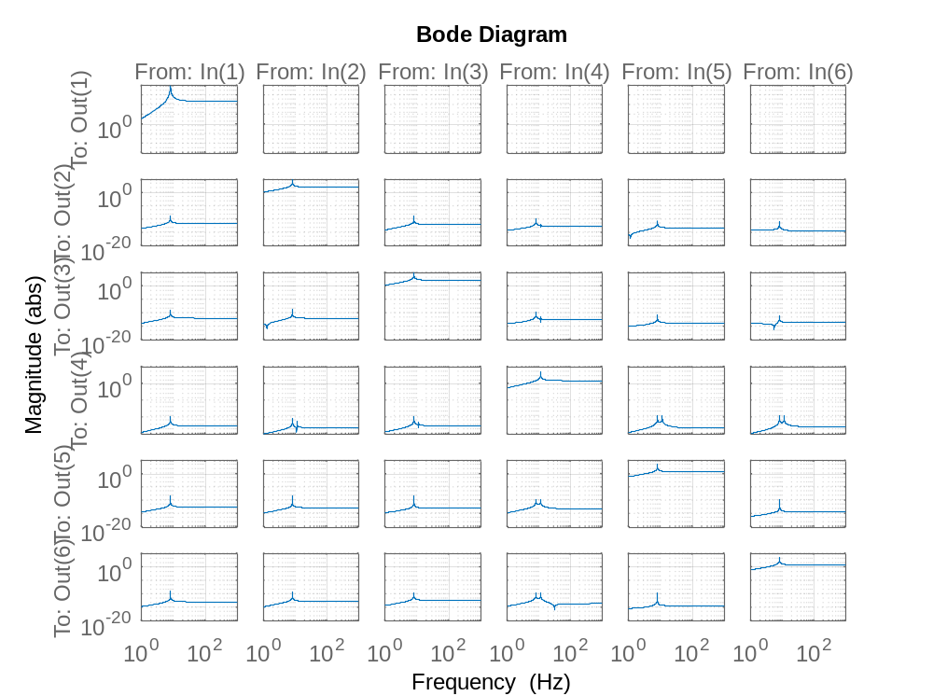
Decoupled plant

Slide 14
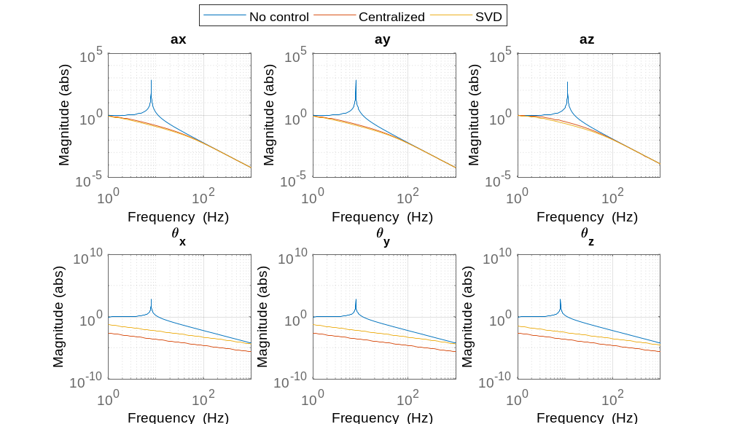


Performance
$a$ (out)
$w$ (in)

Slide 15
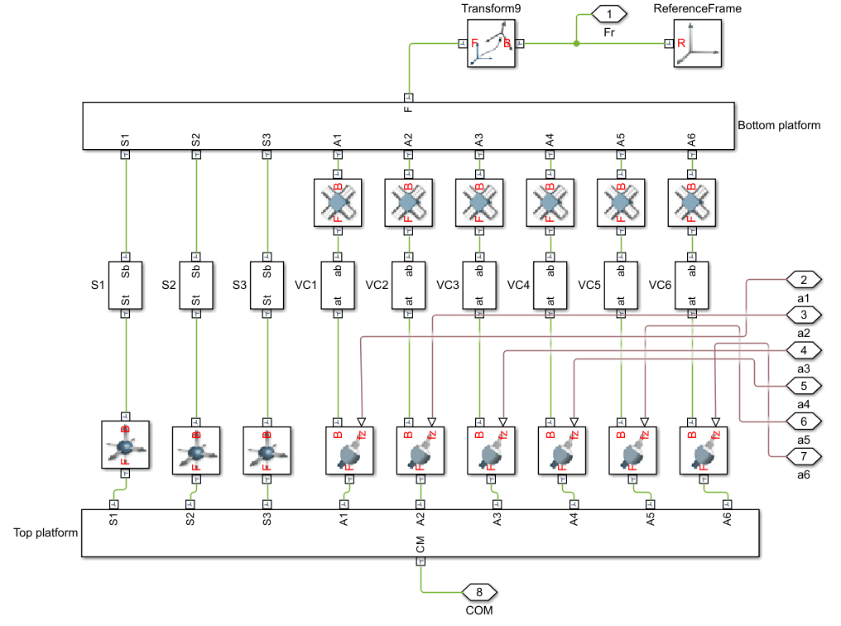
Multi-body simulation (Simscape)

Slide 16
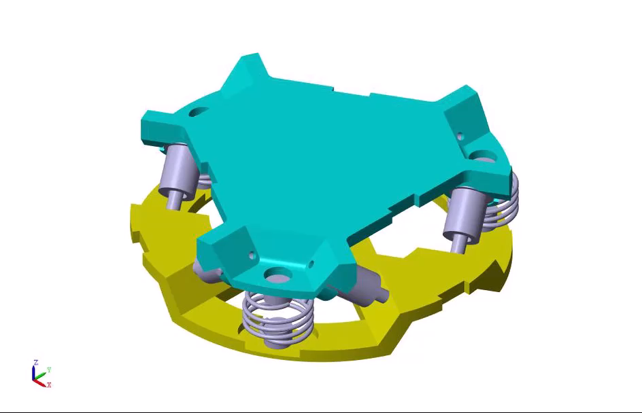
Simulation without control
Fx Fy Fz
Mx My Mz

Slide 17
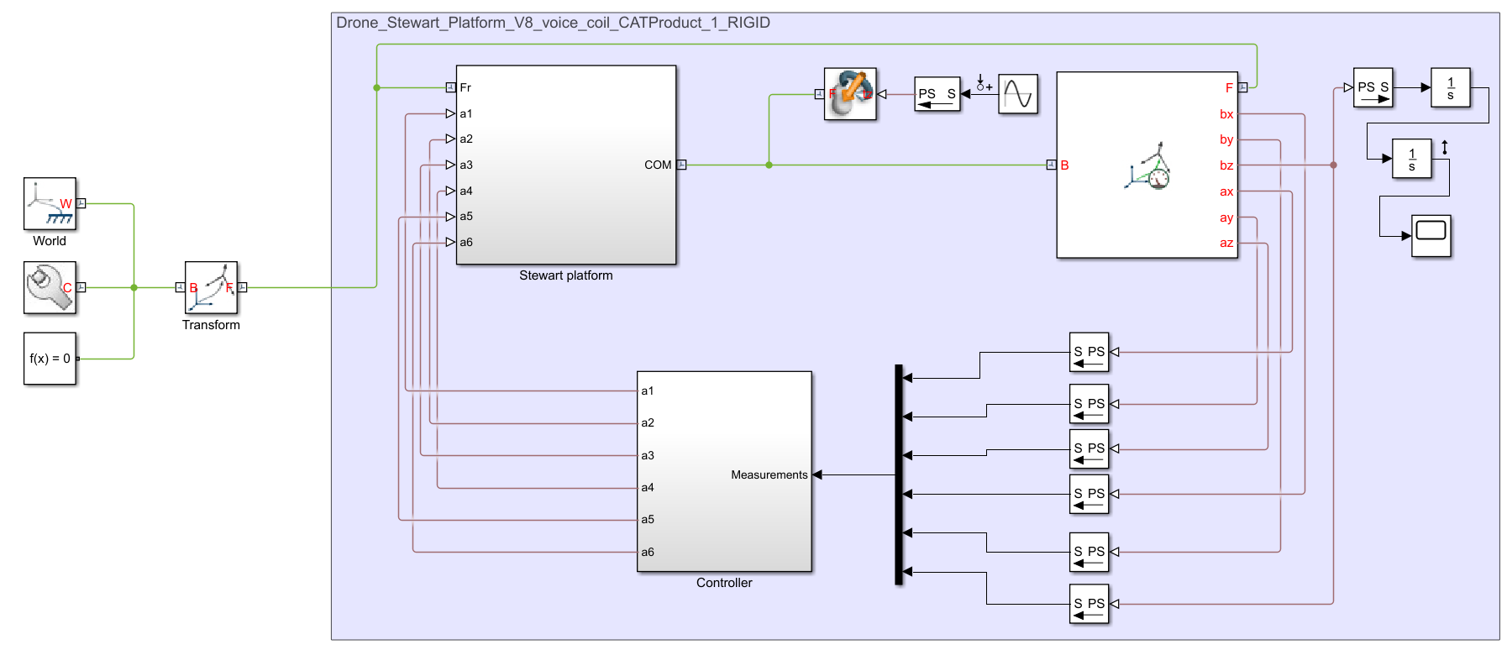
Controller implementation

Slide 18
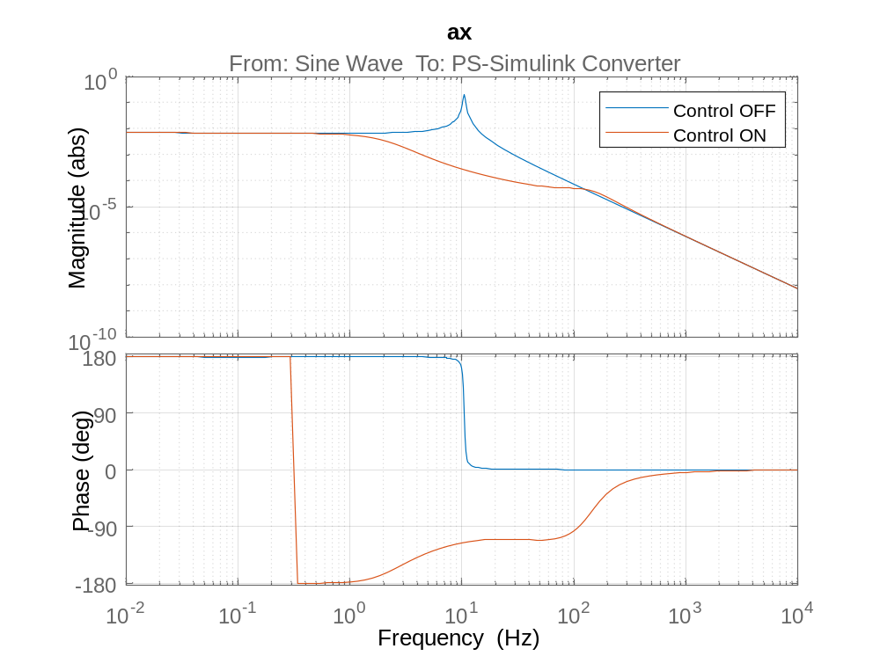

Performance
$F$ (in)
$a$ (out)
Issues:
Measurement of rotations at the COM
Initial condition of the simulation

Slide 19
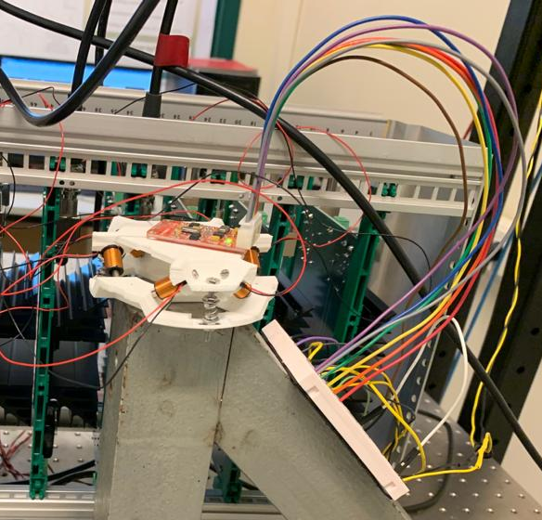
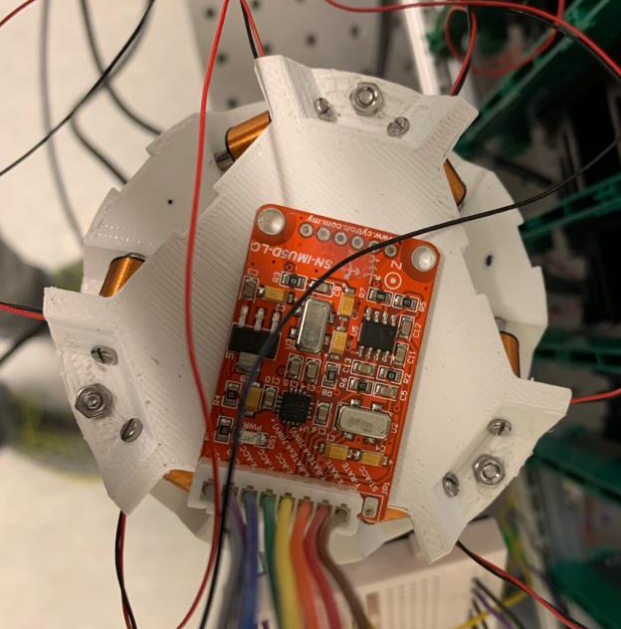
Preliminary experiments

Slide 20
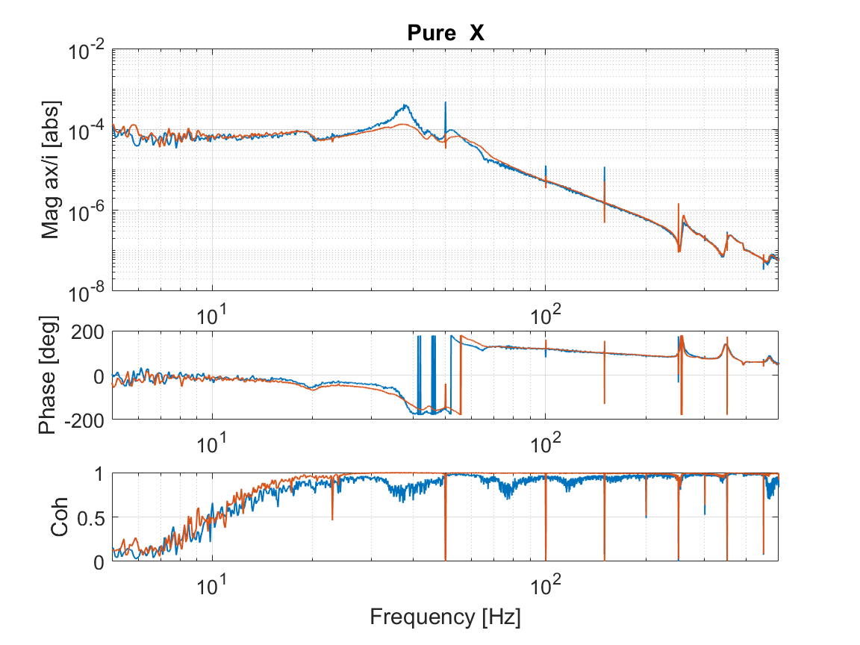
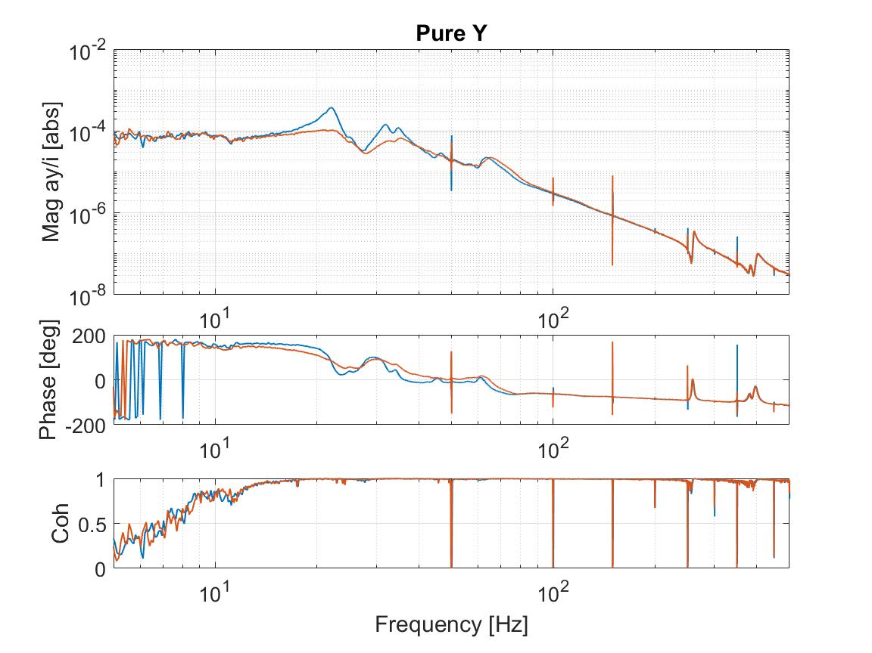
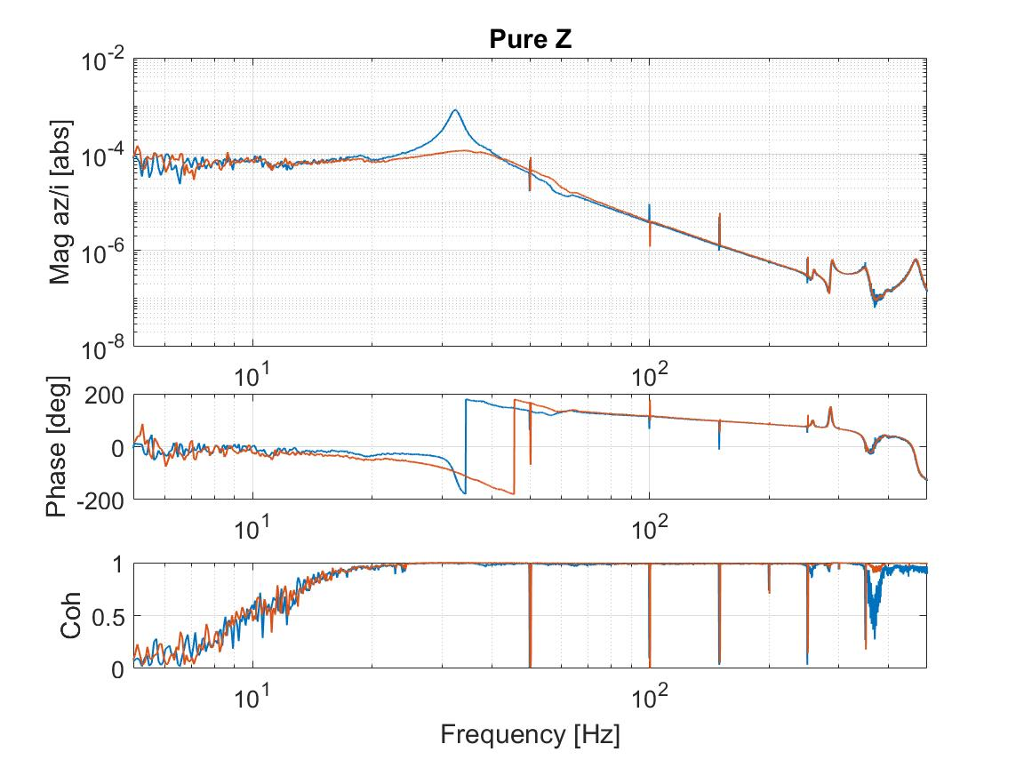
Results
Transfer function from the noise injected in the actuator to the acceleration in X, Y, Z

Slide 21
Future plans
Addressing issues with the Simscape model
Try self sensing with Vicente
Completion of reports
Thank you.

